Slide 1
Research Methodology -Natural Language Processing for Sentence Completion Tasks
Instructor:
Dr. C. –C. Chan.
Team 1:
Adithya Addanki(aa207)
Srinivas Rao Katta(sk189)

Slide 2
Natural Language Processing for Sentence Completion Tasks
Overview (Problem Statement=>Plan)
What, How, Why & Where
Data Set
Models
Bigram, Trigram, Four-gram
Smoothing Techniques
Laplace and Backoff
Latent Semantic Analysis
Comparison
Analysis
References

Slide 3
Natural Language Processing for Sentence Completion Tasks
Natural Language Processing: A branch of computer science dealing with linguistics and machine learning.
Human Computer Interaction
Natural Language Processing
Artificial Intelligence
Linguistics
Sentence Completion Problem
Notes:
Integration of NLP, AI and Linguistics->Sentence Completion Problem
Field of Study is HCI
NLP-> study and application of models
AI-> Training Computers on models
Linguistics-> Sentence Structures and Rootword Analysis

Slide 4
Natural Language Processing for Sentence Completion Tasks
Problem Statement: semantic coherence at sentence level for deducing the right word to replace the blank space in a sentence completion task.
What do we want to find:
Analyze(Comparison study) various machine learning models for determining which could to be used for better performance and to understand which model provides a reasonable solution and where else it fails.
Evaluated for accuracy using MSR Sentence Completion Challenge.

Slide 5
NLP for Sentence Completion Tasks -Research Proposal
What: Primary goal is to automatically deduce the answer of a sentence completion question based on the options provided[multiple choice].
Comparison/Literature Survey and study of various strategies for predicting the answer for a question using different learning techniques (Unigram, Bigram, Trigram and Latent Semantic model classifiers).
How: Existing strategies require a lot of manual intervention for creating testing pool questions. (GRE/SAT style).
Models determine the answers for the blanks in sentences.

Slide 6
NLP for Sentence Completion Tasks -Research Proposal Contd..
Why: Distinguish sense from nonsense.
Identify the semantic features the machine learns with each model.
Window of immediate context <-> Local and logical coherence.
Where: These models could be used to construct various tools which help us induce the syntactic features of English language into a computer.
Machine Translation, Natural Language Generation.
Notes:
Window of Immediate Context-> N-Gram, as in sliding window
Coherence-> features of word-word in a sentence

Slide 7
NLP for Sentence Completion Tasks -Tools and Data Set
Data Set
Microsoft Research Sentence(MSR) Completion Challenge (Microsoft and Bing)
For dataset collection, we obtained training set consisting of data from 522 19th century novels[Proj Gutenberg]. The testing data is a collection of 1040 sentences from Sherlock Holmes novels.
Access through REST and SOAP web services.
Microsoft Web N-gram corpus:
publicly available as an XML Web Service so that it can be updated
makes available various sections of a Web document, specifically, the body, title, and anchor text, as separate models as text contents in these sections
http://weblm.research.microsoft.com/
regular updates for web-scale data
lower case text, no punctuation marks, no spelling corrections, no stemming
Token: 0be45235-bfa5-4e20-88ae-c098e79547f
Notes:
All lower case text
No punctuation marks
No Stemming [No root word behaviors given]

Slide 8
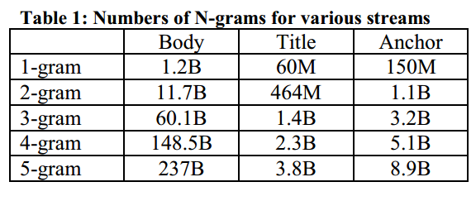
NLP for Sentence Completion Tasks -Data Set Contd..
Markov Assumption: presumption that the future behavior of a dynamical system only depends on recent history.
k -> k-1 most recent states.

Slide 9
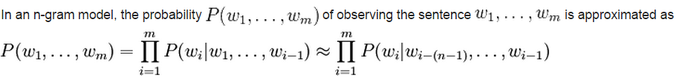

NLP for Sentence Completion Tasks -Models- N-Gram
N-Gram Models (Bag of words)
Bigram
Backward
Backward & Forward
Trigram & Fourgram
Backward, Backward and Forward
Smoothing? Laplace and Backoff
Notes:
Backward-> Depends on preceding N words
Forward-> Depends on succeeding N words

Slide 10
NLP for Sentence Completion Tasks -Models- N-Gram
Features and issues
N-Gram
Coverage: low coverage and
Estimation: increased confusability
Problem with parameter reliability demand; imposes an artificial horizon to N-Gram language model.
Hence typically N-Grams are inherently unable to capture large span relationships in a language
Ex: Stocks fell sharply as a result of the announcement (N=2)
Stocks, as a result of the announcement, sharply fell (N=9 unrealistic for large span relations)
Syntactic dependencies
“The man/men next to the large oak tree near the grocery store on the corner is/are tall.”
Semantic dependencies
“The bird/man next to the large oak tree near the grocery store on the corner flies/talks rapidly.”
Notes:
Ex: Stocks fell sharply as a result of the announcement (N=2)
Stocks, as a result of the announcement, sharply fell (N=9 unrealistic for large span relations)

Slide 11
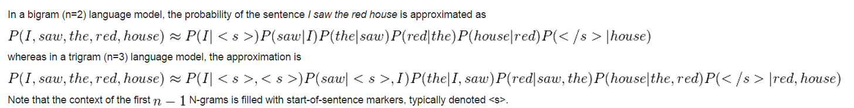
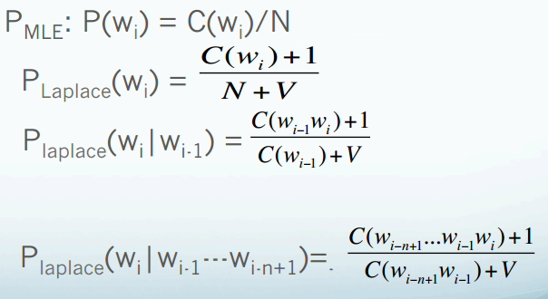
NLP for Sentence Completion Tasks -Models- Smoothing
Smoothing:
1. Laplace
2. Backoff
-Fallback to lower model (N->N-1 Gram model) and check if it has a value, continue until it does.
Notes:
N is count of occurrences for the words preceding or succeeding the blank.
V is number of words in vocabulary.

Slide 12
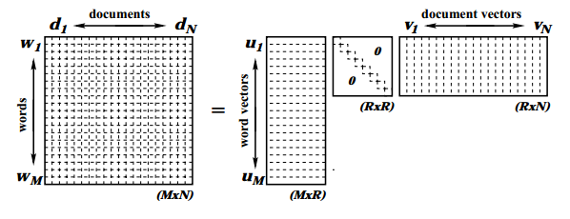
NLP for Sentence Completion Tasks -Models- LSA
Latent Semantic Analysis (Bag of words order unimportant)
Uses SVD to get the relation between words and the documents in the corpus. (Salient relation)
Condenses the Space into orthonormal vectors of words and documents; S as the words in documents could be mostly sparse.
Correct word is deduced by calculating the cosine, i.e. similarity between vectors of target word and rest of the words in a sentence(partial matrix as it is limited)

Slide 13
NLP for Sentence Completion Tasks -Models- LSA
Two words whose representations are close=> tend to appear in similar documents.
Two documents whose representations are close=>tend to convey same semantic meaning.
Respective representations of words and documents that are semantically linked are “close”.
Notes:
Ex:
Change Pop-up to window
Change Window to Popup
Ex:
Change Pop-up to window
Change Window to Popup
Both are mapped to same point in the condensed space, hard to determine in such cases.

Slide 14
NLP for Sentence Completion Tasks -Next?
Comparison study
N-Gram | LSA
Words before or after blank in a particular order | Truly bag of words model
Artificial horizon limited->N? N=1,2,3,4 okay N=9 ? -> unrealistic | Reduces the vector spaces based on Singular values [Feature Extraction]
Can’t capture sentence level [large] relationships as required | Captures sentence level coherence effectively
Word extraction based | Feature Extraction based
No relation is established between words and documents in training set | Relation is established, which groups/clusters the documents into a vector space
Notes:
Previously asked question about benchmarking standard.

Slide 15
Results [before data pre-processing]
Model | Prediction Accuracy
Standard Bigrams | 20.77 %
Forward/Backward Bigrams | 26.25 %
Semantic Coherence + Forward/Backward Bigrams | 25.38 %
Standard Bigrams [Microsoft n-gram corpus] | 33.26 %
Standard Trigrams | 44.33 %

Slide 16
Results [after data pre-processing]
We eliminated insignificant n-grams (for eg. Bigrams with frequency count less than 20). The results changed to the following
Model | Prediction Accuracy
Standard Bigrams | 26.05 % [up from 20.8 %]
Forward/Backward Bigrams | 26.25 % [same as before ]
Semantic Coherence + Forward/ Backward Bigrams | 25.38 % [same as before]

Slide 17
Error Analysis
They seize him and use violence towards him in order to make him sign some papers to make over the girl's __________ of which he may be trustee to them.
A. appreciation
B. activity
C. suspicions
D. administration
E. fortune

Slide 18
Error Analysis
The animal has been _______, and we have the length of its stride.
Sultry
Achieved
Baptized
Moving
Granted

Slide 19
Latent Semantic Analysis
Model | Prediction Accuracy
LSA n-gram language model Unigrams (Holmes Corpus ) | 33.23 %
LSA n-gram language model Trigrams (Holmes Corpus ) | 48.12 %
LSA n-gram language model Fourgrams (Microsoft Corpus ) | >80 %

Slide 20
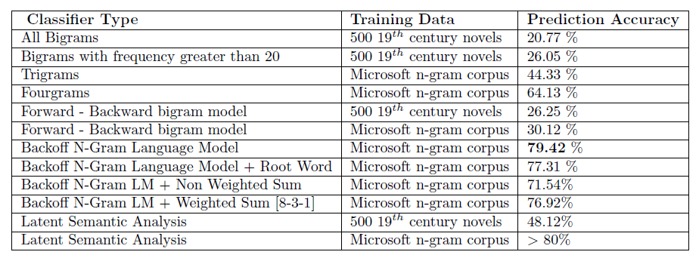
Analysis
Bench Mark
Approximately 92% correct with an average human manually.

Slide 21
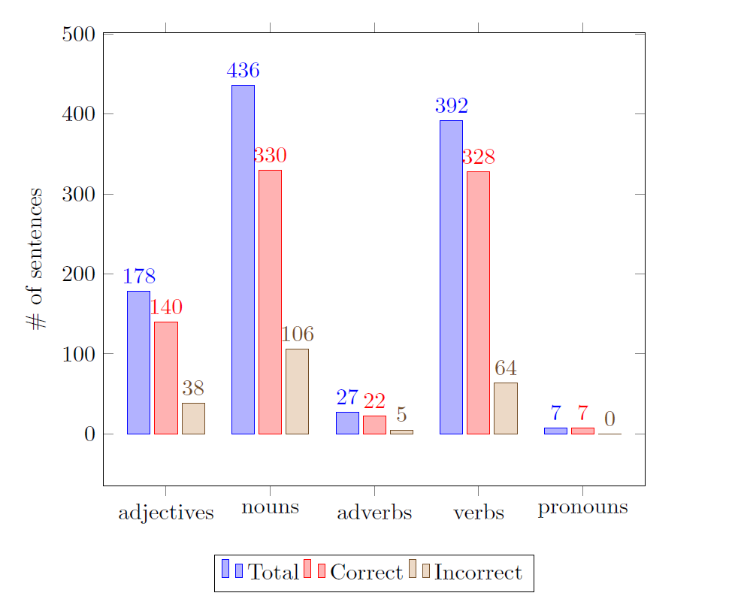
Analysis

Slide 22
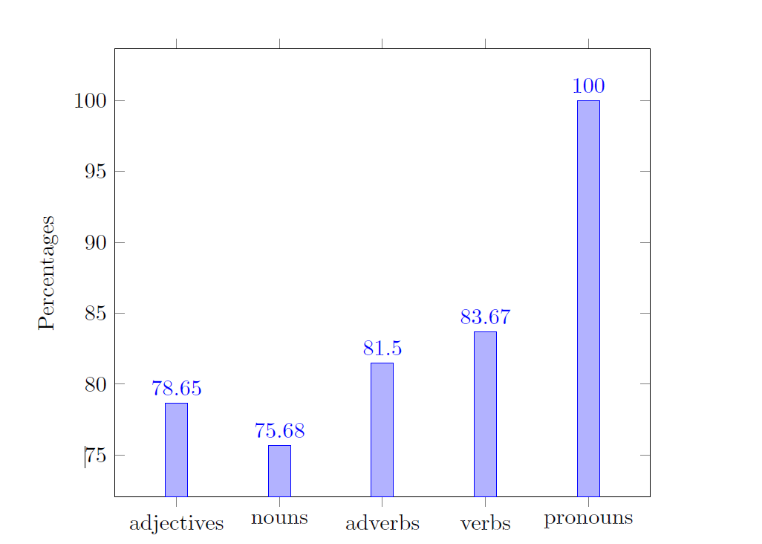
Analysis

Slide 23
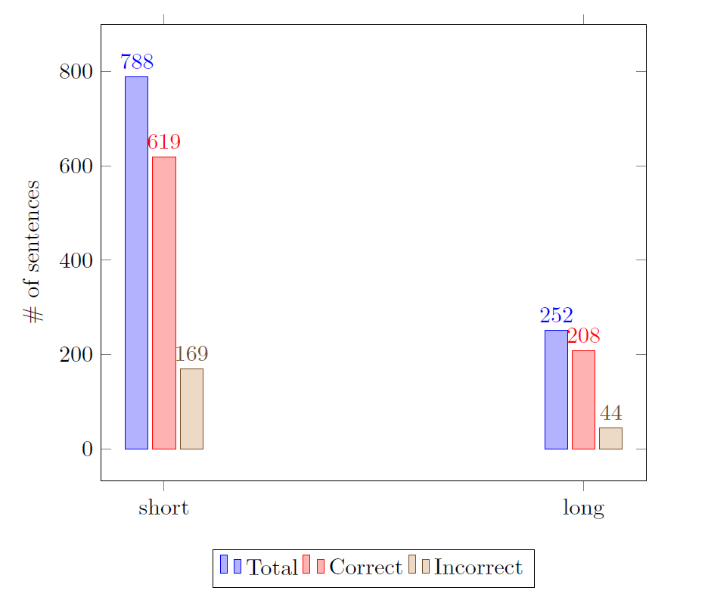
Analysis

Slide 24
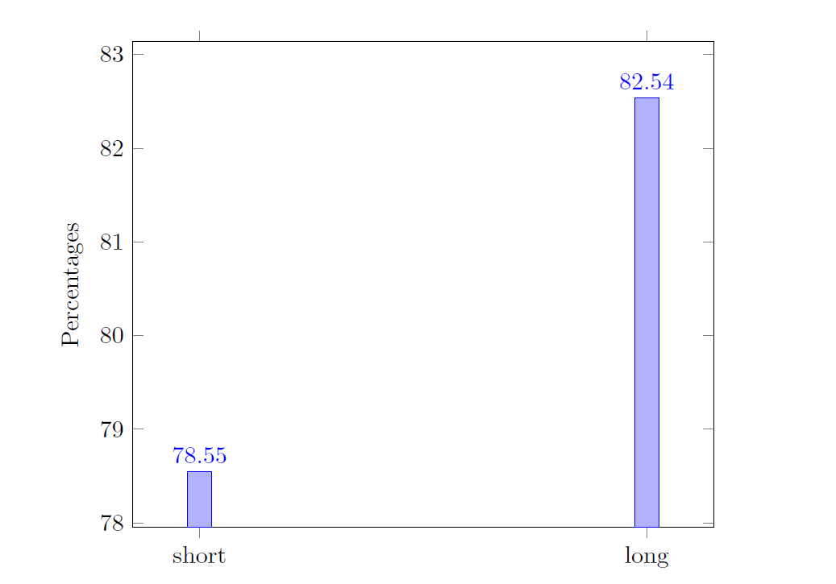
Analysis

Slide 25
Challenges
Dataset of 522 novels seemed small as per the accuracy, had to train with MS N-Gram Corpus, for better accuracy[approx 0.3B vs 1.2B unique words].
MS N-Gram corpus, returns just probability of the N-Gram, could not use for LSA, as it requires word frequencies.
Root word based sentence completion
Bench Mark -> Human IQ with Model i.e., Computers IQ
Still requires better technology integrations to help imbibe human characteristics and judgment to Computers.

Slide 26
References
http://weblm.research.microsoft.com/
Bellegarda, J.R., "Exploiting latent semantic information in statistical language modeling," Proceedings of the IEEE , vol.88, no.8, pp.1279,1296, Aug. 2000 doi: 10.1109/5.880084
Geoffrey Zweig and Chris J. C. Burges. 2012. A challenge set for advancing language modeling. InProceedings of the NAACL-HLT 2012 Workshop: Will We Ever Really Replace the N-gram Model? On the Future of Language Modeling for HLT (WLM '12). Association for Computational Linguistics, Stroudsburg, PA, USA, 29-36.
Geoffrey Zweig, John C. Platt, Christopher Meek, Christopher J. C. Burges, Ainur Yessenalina, and Qiang Liu. 2012. Computational approaches to sentence completion. In Proceedings of the 50th Annual Meeting of the Association for Computational Linguistics: Long Papers - Volume 1 (ACL '12), Vol. 1. Association for Computational Linguistics, Stroudsburg, PA, USA, 601-610.

Slide 27
Queries

Slide 28
Thank You

